Slide 1

PYTHON IN INDUSTRY
Engr. Md. Mosarraf Hossen

Slide 2





Who Am I
Engr. Md. Mosarraf Hossen
Executive Engineer (System Analyst)
ICT, HQ, WZPDCL

Slide 3


To make you aware of awesome career in Python Programmer
Goal

Slide 4

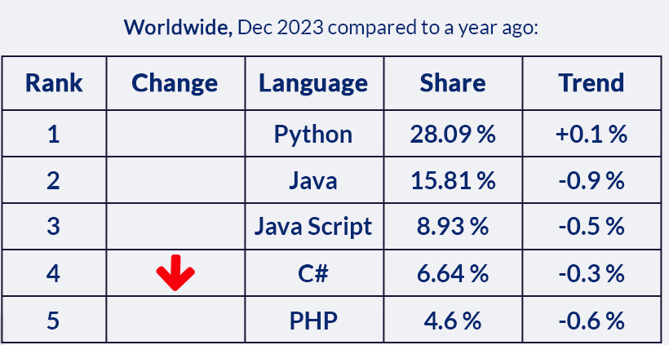
Popularity of Programming
Languages
MH
Source: https://www.synergisticit.com/

Slide 5
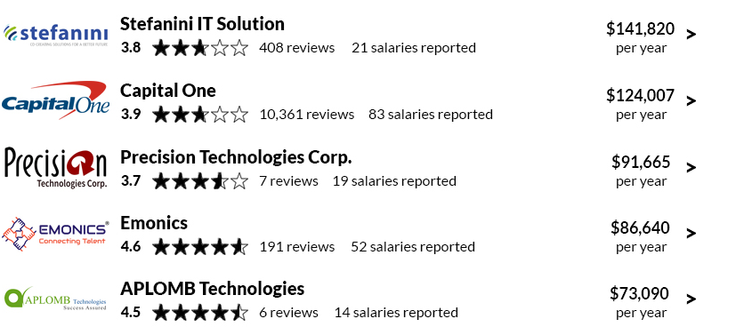
Top companies for Python
Developers in USA
Developed by Guido van Rossum in late 1980s
Named after a TV show called “Monty Python”
Python interpreter developed using C language
Open source – so you can contribute to it as well
MH
Source: https://www.synergisticit.com/

Slide 6
Python in Industry
Python is a versatile and powerful programming language that has found widespread adoption across diverse industries. From data analytics to web development, Python's intuitive syntax and extensive library ecosystem make it a popular choice for professionals and students alike.
MH

Slide 7
History of Python
Developed by Guido van Rossum in late 1980s
Named after a TV show called “Monty Python”
Python interpreter developed using C language
Open source – so you can contribute to it as well
MH

Slide 8

Data Science and Analytics
Python's extensive data science libraries, such as NumPy, Pandas, and Scikit-learn, make it a go-to tool for data exploration, cleaning, and predictive modeling. Professionals in fields like finance, healthcare, and e-commerce rely on Python for data-driven decision-making.

Slide 9
Web Development
The Django and Flask web frameworks, along with Python's robust standard library, provide developers with the tools to build dynamic, scalable, and secure web applications. Python's readability and ease of use make it a popular choice for both small startups and large enterprises.

Slide 10


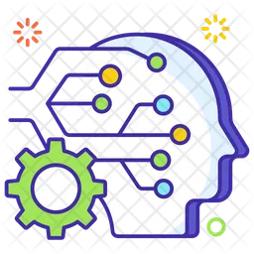

Automation and DevOps
Process Automation
Cloud Infrastructure
Python's powerful scripting capabilities enable developers to automate repetitive tasks, improving efficiency and reducing the risk of human error.
Python is widely used in DevOps practices, helping teams manage cloud-based infrastructure and deploy applications seamlessly.
Robotics
Machine Learning
Python's simple syntax and extensive libraries for controlling hardware make it a popular choice for programming robotic systems.
Python's Scikit-learn and TensorFlow libraries make it a leading choice for developing and deploying advanced machine learning models in various scientific domains.

Slide 11
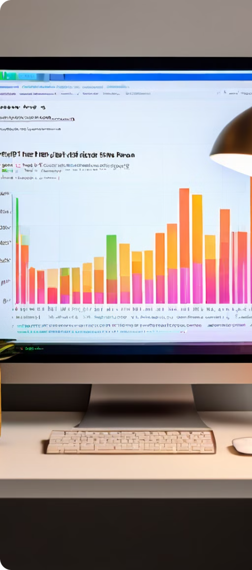
Scientific Computing
Numerical Analysis
Visualizations
Python's NumPy and SciPy libraries provide powerful tools for numerical computing, enabling researchers and scientists to perform complex mathematical calculations and simulations.
Python's Matplotlib and Plotly libraries allow for the creation of high-quality, publication-ready data visualizations, aiding in the communication of scientific findings.

Slide 12
Python for Electronics Engineers
Python and Embedded System
Python tools for Scraping
Steadily Increasing adaption
Board
MicroPython
Raspberry Pi
Lots and lots of documentation and tutorials available online
BeautifulSoap
Machanize
Scrapmark
Scrapy

Slide 13

Bioinformatics
Sequence Analysis
Genomics
Python's Biopython library provides tools for working with biological sequence data, enabling researchers to perform tasks like sequence alignment and phylogenetic analysis.
Python is widely used in genomics research, with libraries like Pandas and Matplotlib facilitating the manipulation, analysis, and visualization of large-scale genomic data.
1
2
3
Structural Modeling
Python's libraries, such as PyMOL and Biopython, allow bioinformaticians to visualize and analyze the 3D structures of proteins and other biomolecules.

Slide 14
Machine Learning and AI
Rapid Prototyping
Scalable Solutions
Python's easy-to-use syntax and extensive library ecosystem make it an ideal language for quickly prototyping and experimenting with machine learning models.
Libraries like TensorFlow and PyTorch enable Python to be used for building and deploying large-scale, production-ready AI and machine learning applications.
Diverse Applications
Community Support
Python's versatility allows it to be applied to a wide range of AI and machine learning problems, from computer vision to natural language processing.
Python's active and collaborative community provides a wealth of resources, tutorials, and pre-built solutions to accelerate the development of AI/ML projects.

Slide 15
Benefits of Python Scripting
1
Increased Productivity
2
Improved Efficiency
Python's concise syntax and rich libraries streamline development, reducing development time and effort.
Python automates repetitive tasks, freeing up time for more complex and creative endeavors.
3
Enhanced Collaboration
4
Scalable Solutions
Python's readability and widespread adoption facilitate knowledge sharing and collaborative development.
Python's robust libraries and frameworks enable the development of scalable and maintainable solutions.

Slide 16

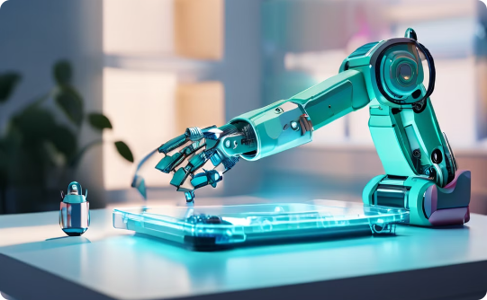

Automating Repetitive Tasks
Streamlining Workflows
Boosting Efficiency
Reducing Errors
Python scripts can automate tedious tasks, such as data entry or file processing, saving you time and effort.
By automating tasks, you can focus on more strategic and creative work.
Python scripts minimize human error, ensuring consistency and accuracy in repetitive processes.

Slide 17




Extracting and Analyzing Data
Data Acquisition
Python scripts can be used to extract data from various sources, including websites, databases, and APIs.
Data Cleaning
Once extracted, data often requires cleaning and preprocessing to remove errors, inconsistencies, and missing values.
Data Exploration
Python libraries provide tools for visualizing and summarizing data, revealing patterns and trends.
Data Modeling
Python allows you to build statistical and machine learning models to predict outcomes and gain insights from data.

Slide 18

Integrating Python with Other Tools
Python seamlessly integrates with other programming languages and tools, creating a versatile and powerful environment.
This allows you to leverage the strengths of different tools to build sophisticated applications, automate complex processes, and tackle diverse challenges.

Slide 19




Improving Productivity and Efficiency
Faster Development
Streamlined Workflows
Enhanced Analysis
Improved Collaboration
Python's concise syntax and extensive libraries accelerate development, reducing the time needed to build applications.
Python scripts automate repetitive tasks, freeing up time for more strategic and creative work.
Python libraries provide efficient data analysis tools, allowing you to gain insights from data faster.
Python's readability and popularity promote knowledge sharing and collaborative development, fostering team efficiency.

Slide 20




Developing Scalable and Maintainable Code
Modular Design
1
Breaking down code into reusable components.
2
Clear Documentation
Explaining code functionality and usage.
3
Testing and Debugging
Ensuring code quality and reliability.
4
Version Control
Tracking code changes and collaboration.
Python's modular design promotes code reuse and maintainability, reducing redundancy and improving code quality.
Well-documented code is easier to understand and maintain, fostering collaboration and knowledge sharing.
Thorough testing and debugging ensure code reliability and identify potential issues early on.
Version control systems, like Git, track code changes and allow for collaboration and rollback capabilities.

Slide 21
Enhancing Decision-Making Capabilities
Data-Driven Insights
Predictive Modeling
Python's data analysis capabilities reveal patterns and trends that inform strategic decision-making.
Machine learning models predict future outcomes and identify potential risks and opportunities.
Automated Reporting
Scenario Analysis
Python automates the generation of reports, providing timely and accurate information for decision-making.
Python scripts simulate different scenarios, allowing you to evaluate the potential impact of various decisions.

Slide 22





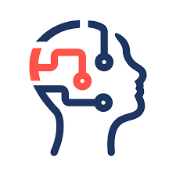

Which Organization Use Python
Google
Microsoft
Youtube
Facebook
Red Hat
NASA
…

Slide 23
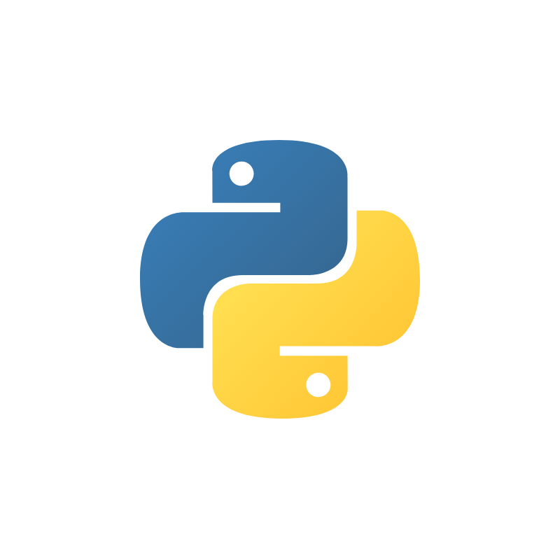
What else can be done in Python
Chatbots
Blockchain
Configuration Management Tools
Desktop and Mobile Applications
Game Development
Language Development
Internet of things (IoT)

Slide 24



Python's Bright Future
Continued Growth
As industries embrace the power of data and automation, the demand for Python developers continues to rise, ensuring the language's long-term relevance.
Expanding Ecosystem
Python's vibrant community of contributors ensures a steady stream of new libraries and tools, keeping the language at the forefront of technological innovation.
Versatility Across Domains
Python's ability to adapt to diverse use cases, from web development to scientific computing, solidifies its position as a must-learn language for professionals in various industries.

Slide 25
Thank you

